Slide 1
Conflicts of interest and commitment: risk and internal audit considerations to elevate community engagement
November 10, 2022

Slide 2
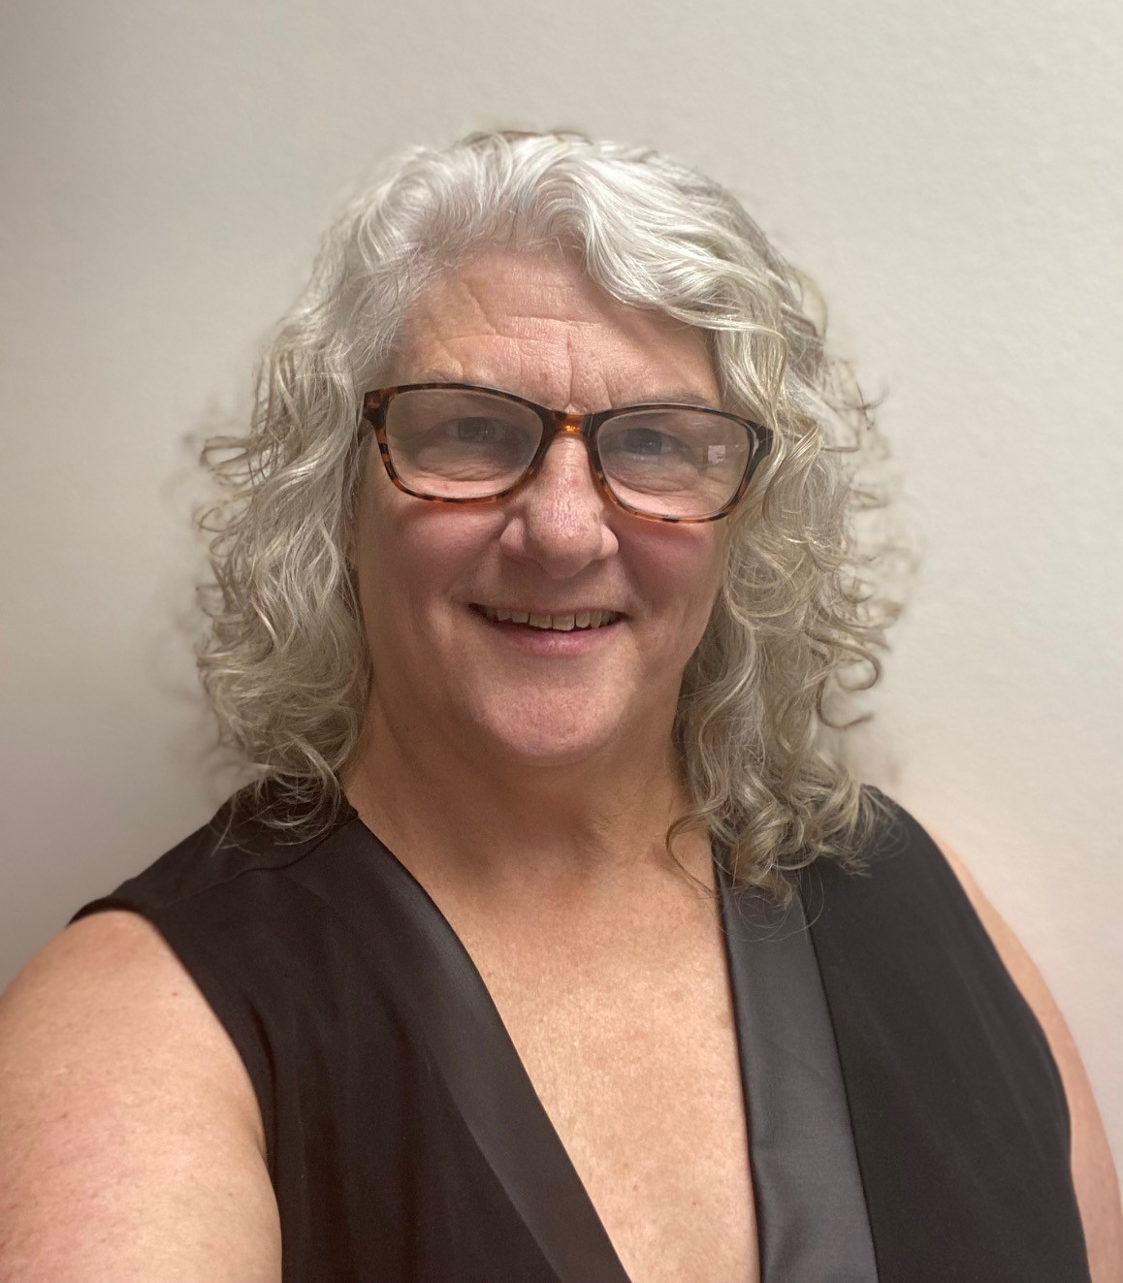
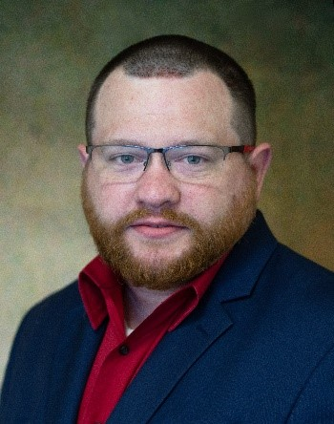
Don’t forget to connect with us on social media!
ACUA Virtual Learning Director
Lisa Gendusa, CIA, CFE
Internal Auditor
Texas State University System
ACUA Virtual Learning Volunteer
Jonathan Stadig
Senior Auditor
University of Massachusetts

Slide 3
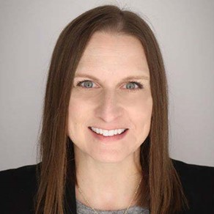
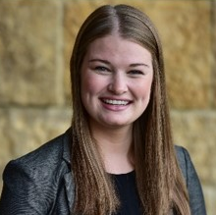
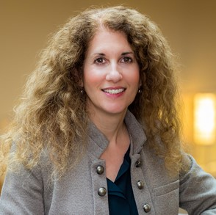
Meet your presenters:
Tina Griffiths
Deloitte & Touche LLP
Managing Director
Higher Education Internal Audit
Tara Atkins
Deloitte & Touche LLP
Manager
Higher Education Internal Audit
Lisa Palazzo
Case Western Reserve University
University Chief Compliance & Privacy Officer

Slide 4
Objectives
Understand Risks
Understand the risks related to conflicts of interest (COI) and commitment (COC) and ineffective conflict management
Understand potential steps within an internal audit workplan to assess COI & COC and identify where gaps may exist at your university
Explore strategies internal audit departments can deploy to effectively manage conflicts and promote external involvement
Assess COI/COC
Manage Conflicts

Slide 5
Polling Question #1
Please indicate your level of confidence in the current COI/COC process at your institution:
Very confident
Somewhat confident
My institution has a process but I’m not confident in it
My institution does not have a COI/COC process that I am aware of

Slide 6
Agenda
Overview
COI & COC
Risks
Controls
Internal Audit Workplan Considerations
Questions for consideration
Potential testing areas
Managing Outside Interests, Commitments and Conflicts – Leading Practices
Addressing challenges
Additional considerations
Discussion and Q&A

Slide 7
Overview

Slide 8
Overview
COI & COC Overview
Conflict of Interest
Conflict of Commitment
When a personal financial interest may affect, or appear to affect, an employee’s judgment in carrying out the requirements defined in their employment contract
A commitment of time where an employee partakes in an activity that obstructs or appears to interfere with their ability to fulfil the requirements defined in their employment contract
Beneficial Relationships
Combating corruption while promoting external engagement

Slide 9
Overview
Illustrative Risks Related to COI & COC
Business Risks
Corruption or kickbacks
Loss of institutional resources
Inappropriate procurement process
Reputational risk
Research Risks
Compromised research results or findings
Defunding or claw back of funds
Insufficient time spent on projects
Reputational risk

Slide 10
Polling Question #2
Which of the following is NOT a risk related to COI and COC?
Reputational risk
Risk of defunding
Risk of employees volunteering in the community
Risk of corruption institutionally or in specific programs

Slide 11
Overview
Internal Controls Related to COI & COC
COI & COC disclosures
Vendor selection process
1
4
Approval requirements
Hiring process
2
5
Segregation of duties
Recusal process
3
6

Slide 12
Internal Audit Workplan Considerations

Slide 13
Internal Audit Workplan Considerations
Questions to Consider
How are outside commitments reported and tracked?
Governance
Disclosures
Risk Acceptance
How does my institution determine what outside interests or commitments are acceptable?
Are policies and procedures over COI & COC sufficient?

Slide 14
Internal Audit Workplan Considerations
Testing
VENDOR & PROCUREMENT
GRANT MANAGEMENT
DISCLOSURES
HIRING
RECUSAL PROCESS
When and what to disclose? Is approval needed?
Does one individual have access to perform all steps of the procurement process?
Does one individual have the ability to make the final decision?
Is there potential to compromise professional judgment in conducting research?
When should an employee recuse themselves of a decision?
Disclosure process
Scope of disclosures
Outside activity:
-allowable?
-reported?
-approved (if needed)?
-SOD maintained?
Procurement and bid process
Vendor selection process
Segregation of Duties (SOD) controls
Data analytics use
HR policies for fair hiring
Hiring practices
Outside activity disclosure pre-employment
Consistent salary and job posting
Principal Investigator’s (PI) financial and personal interests
PI disclosures
Effort allocation
External activities
COI training
Recusal process
Training and awareness
Methods and support to recuse

Slide 15
Managing Outside Interests, Commitments and Conflicts – Leading Practices

Slide 16
Polling Question #3
Where does responsibility of COI/COC sit at your institution?
The Provost
School/department leadership
The Office of General Counsel
Research and Administration
Compliance
Other
I do not know who holds responsibility

Slide 17
Managing Outside Interests, Commitments and Conflicts – Leading Practices
Common Challenges and Ways to Address Them
Maintaining a centralized and non-duplicative process
Communicating the “why” to your University
Using data, effectively as needed
Timely updates to reporting as new interests or activities emerge
Encouraging or requiring reporting and building a system of transparency

Slide 18
Managing Outside Interests, Commitments and Conflicts – Leading Practices
Additional Considerations and Leading Practices
Building a relationship between COI and COC
Managing conflicts
Tracking outside interests, but not discouraging effective involvement
Simplifying the approval process
Key Considerations

Slide 19
Polling Question #4
Which of the following questions should be asked to evaluate COI/COC at your institution?
What is the impact of non-compliance?
What is the reporting requirement frequency?
How is it determined which interests/commitments are acceptable?
d. All of the above.

Slide 20
Discussion
Q&A

Slide 21
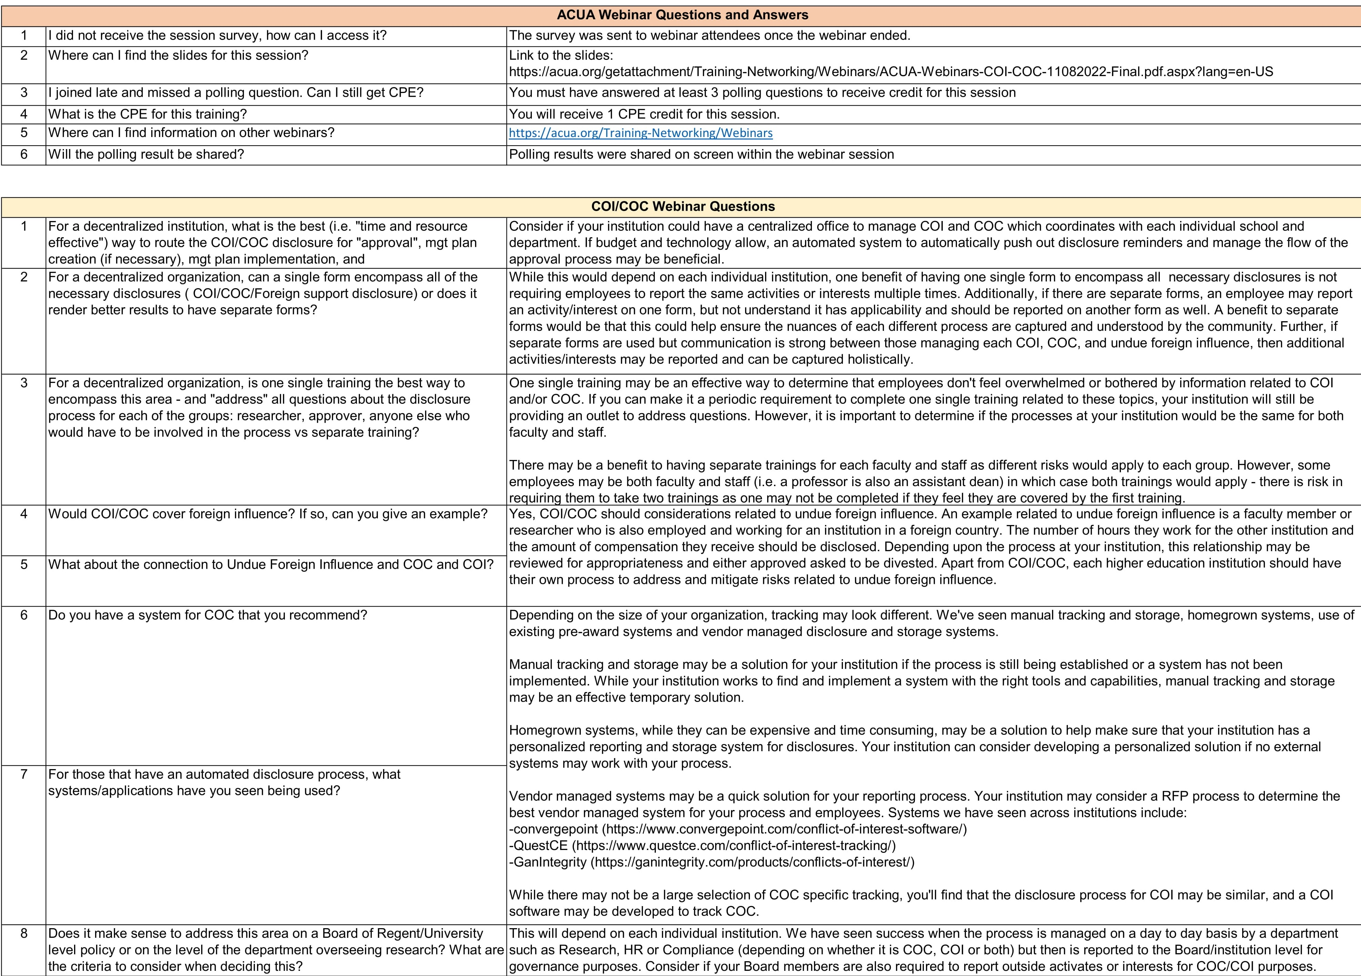
Discussion
Q&A

Slide 22
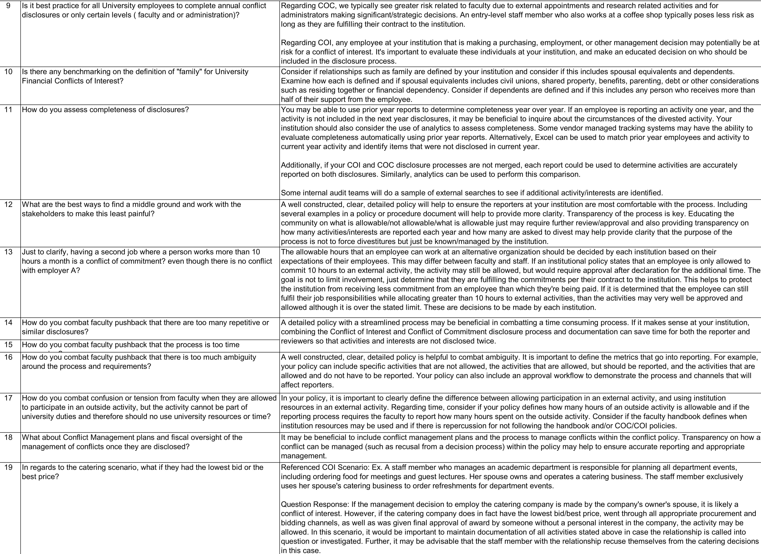
Discussion
Q&A

Slide 23
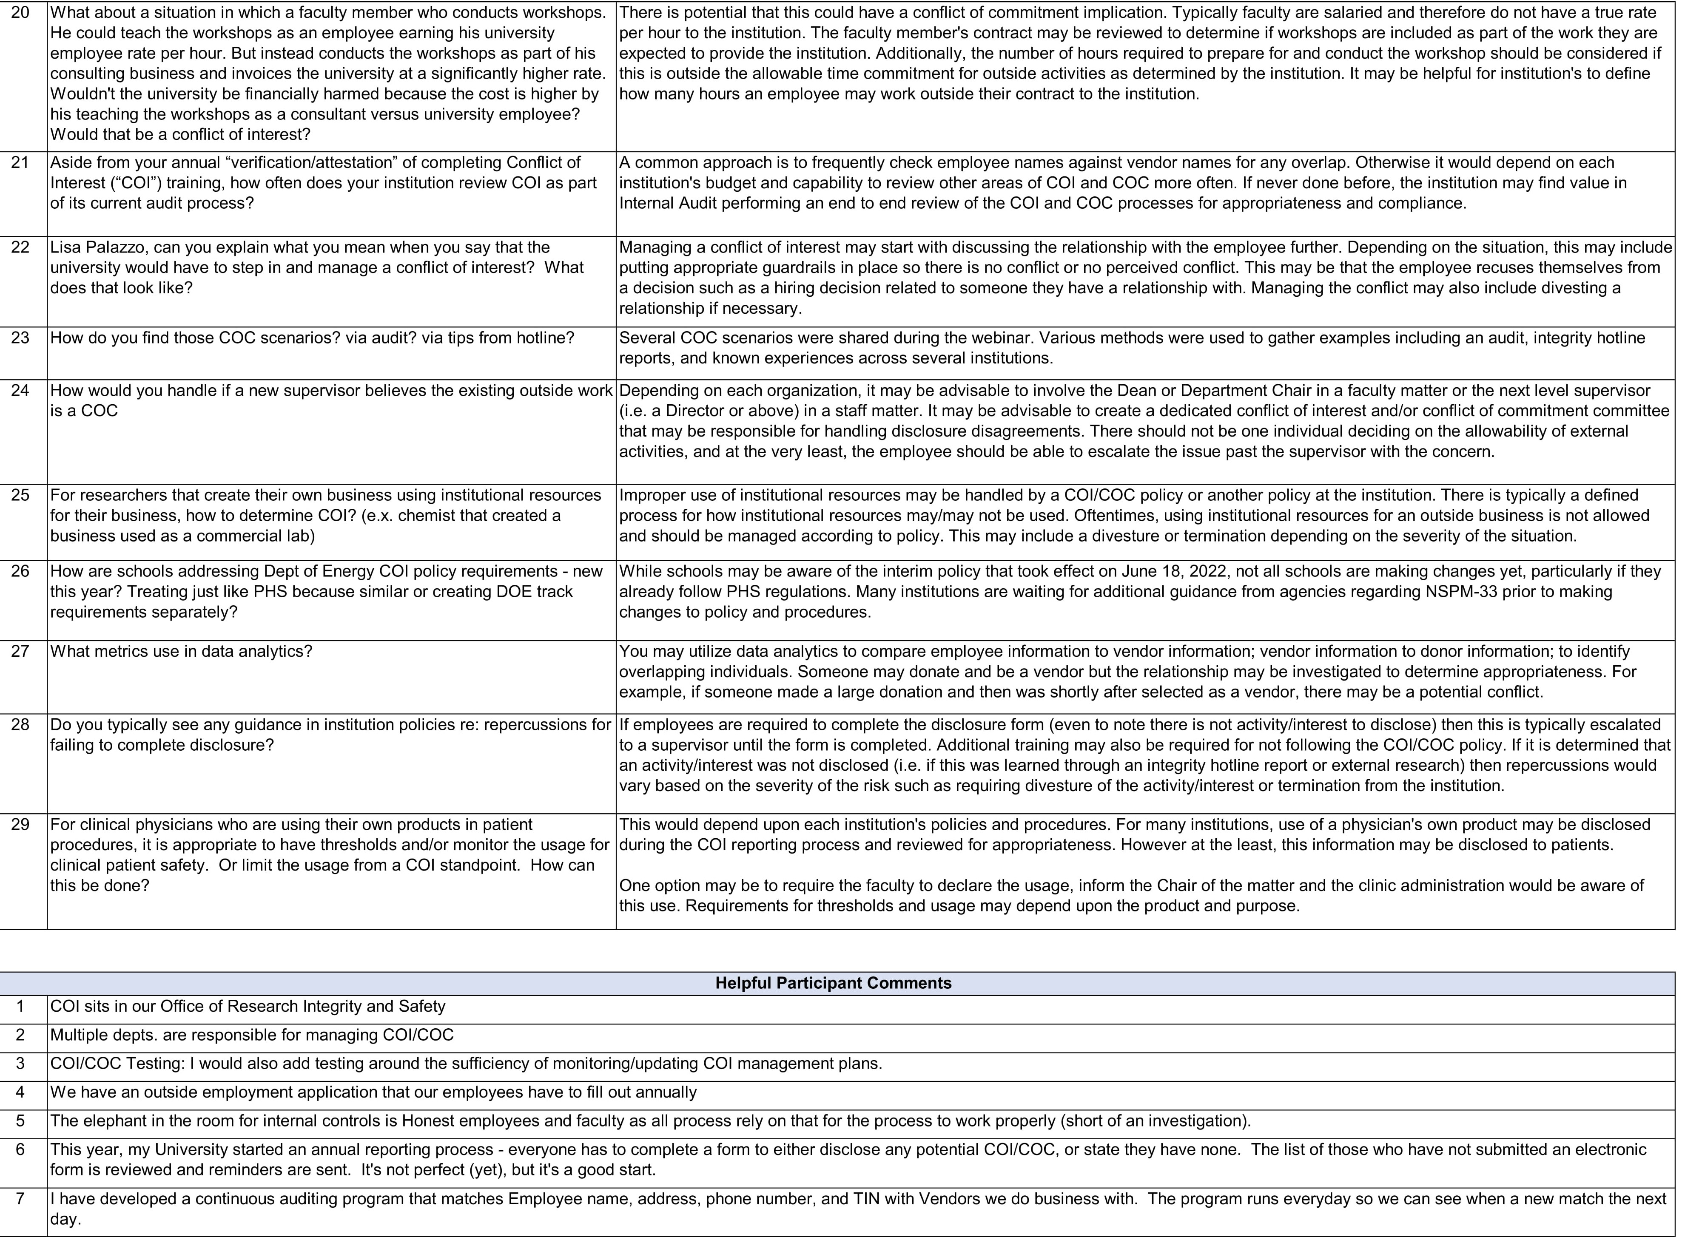
Discussion
Q&A

Slide 24
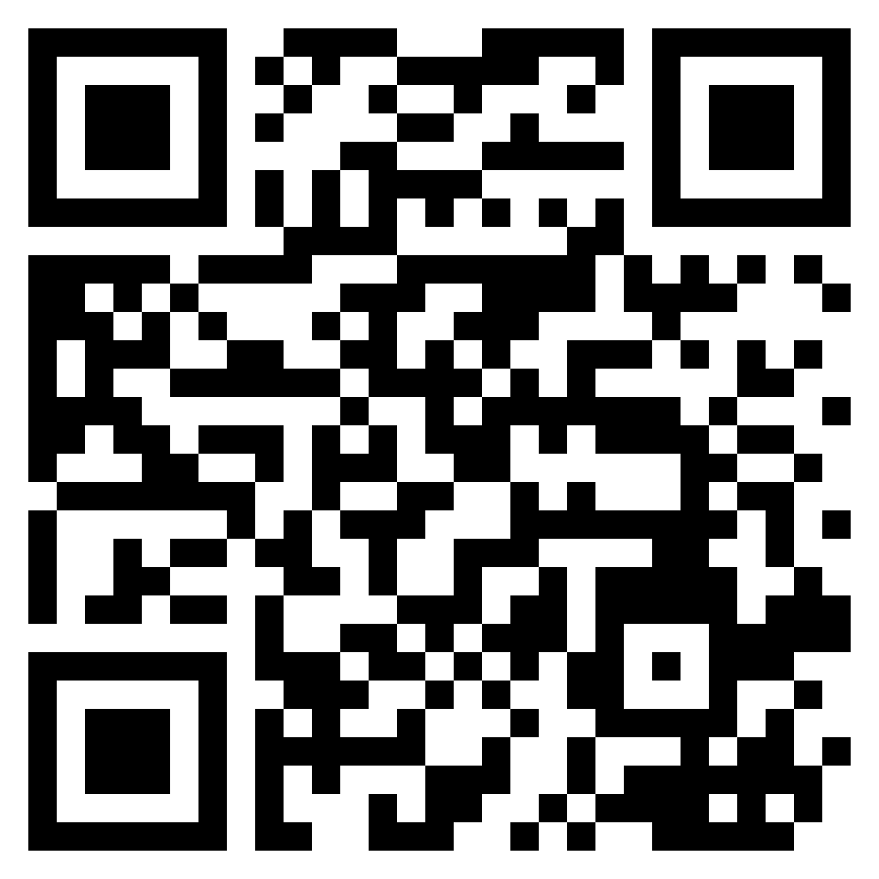
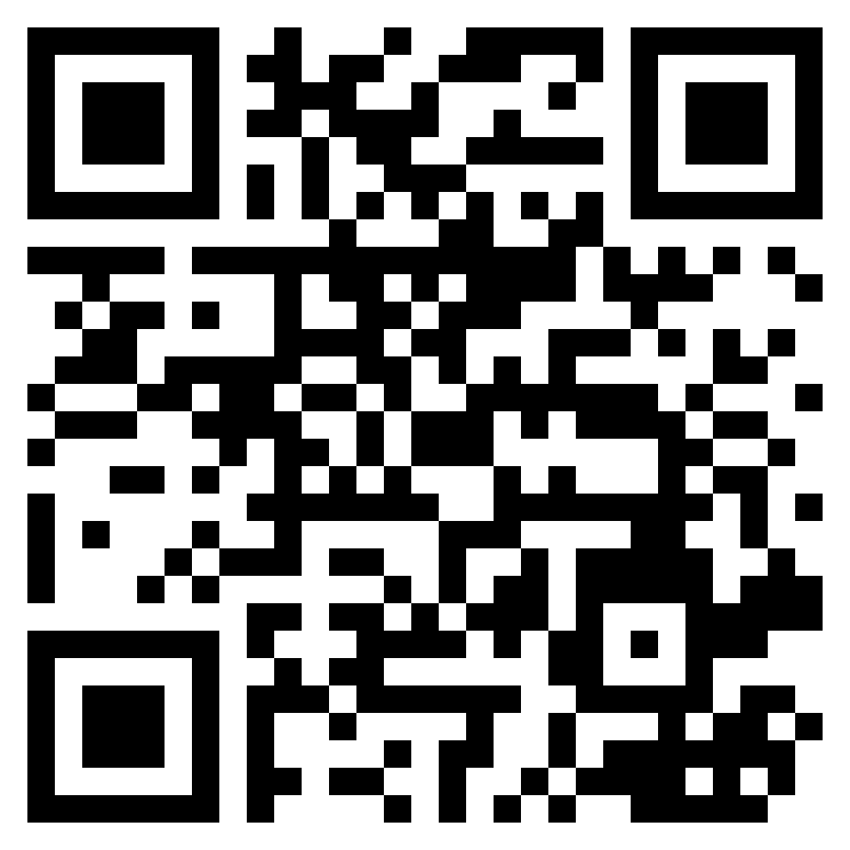
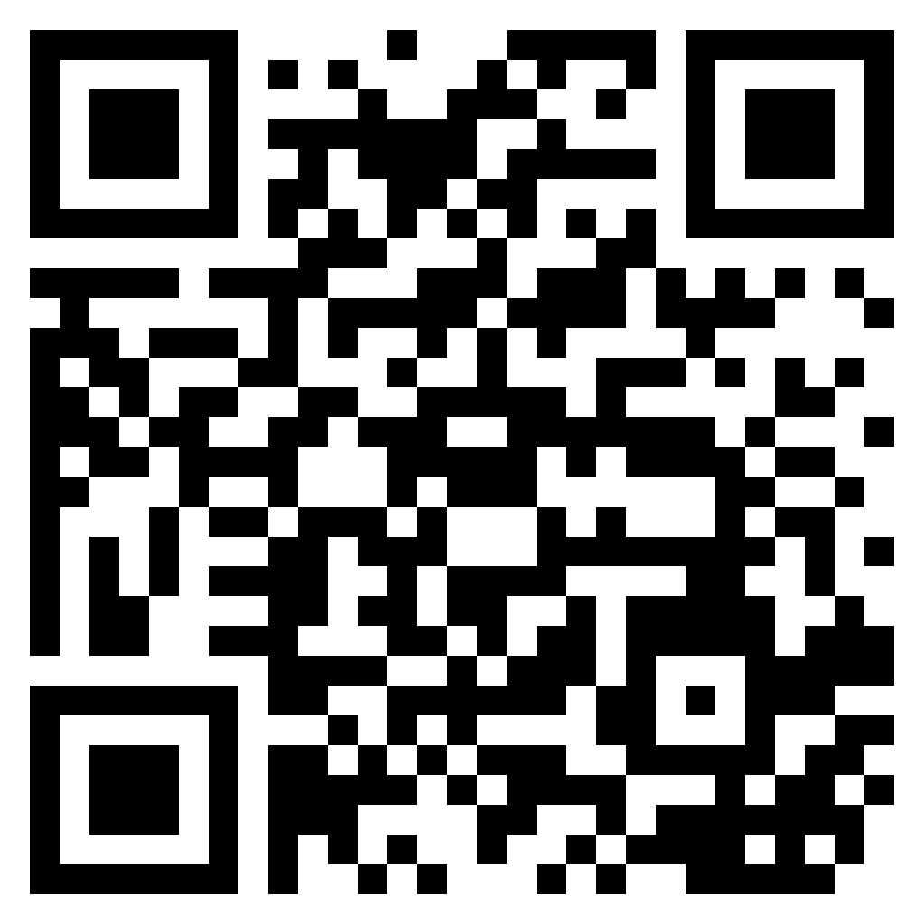
QR Codes to LinkedIn
Tina Griffiths
tgriffiths@deloitte.com
Tara Atkins
taratkins@deloitte.com
Lisa Palazzo
lxp66@case.edu

Slide 25
This presentation contains general information only and the presenters are not, by means of this presentation, rendering accounting, business, financial, investment, legal, tax, or other professional advice or services. This presentation is not a substitute for such professional advice or services, nor should it be used as a basis for any decision or action that may affect your business. Before making any decision or taking any action that may affect your business, you should consult a qualified professional advisor.
The presenters shall not be responsible for any loss sustained by any person who relies on this presentation.
As used in this document, “Deloitte” means Deloitte & Touche LLP, a subsidiary of Deloitte LLP. Please see www.deloitte.com/us/about for a detailed description of our legal structure. Certain services may not be available to attest clients under the rules and regulations of public accounting.

Slide 26
Upcoming ACUA Events
Webinars
December 8, 2022 – BDO
Developing an Audit of Research Activities Leveraging Results of OIG and Single Audits
Audit Interactive
March 27-29, 2023 in Denver, CO

Slide 28
Last Kick Starter Released was on October 15th!
Foreign Gift and Contract Reporting Process
Will be available in the members-only Audit Tools
section of www.ACUA.org

Slide 29
ACUA Kick Starters
Use a Kick Starter to launch your next audit!
Developed by ACUA members with subject matter expertise
Focused on higher education specific topics
https://acua.org/Audit-Tools/ACUA-Kick-Starters
Do you have a great idea for an ACUA Kick Starter? Contact John Winn at HJWINN@mailbox.sc.edu.

Slide 30
ACUA Mentorship Program
Mentorship is a proven method to help colleagues feel supported, drive workplace satisfaction, and foster member engagement in higher ed auditing.
The program is no longer focused on only small audit shops! The program has been expanded to be more inclusive of all types of shops.
The program is only a one-year commitment, but we encourage the mentorship to continue even after one year.
Consider signing up! Watch for registration deadlines to be communicated via email. For more information, go to https://acua.org/Member-Resources/Mentorship-Program

Slide 31
Stay Updated
The College and University Auditor is ACUA's official journal. Current and past issues are posted on the ACUA website.
News relevant to Higher Ed internal audit is posted on the front page. Articles are also archived for your reference under the Resources/ACUA News.
Get Involved
The latest Volunteer openings are posted on the front page of the website.
Visit the listing of Committee Chairs to learn about the various areas where you might participate.
Nominate one of your colleagues for an ACUA annual award.
Submit a conference proposal.
Present a webinar.
Become a Mentor
Write an article for the C&U Auditor.
Write a Kick Starter.
Connect with Colleagues
Subscribe to one or more Forums on the Connect ACUA to obtain feedback and share your insights on topics of concern to higher education internal auditors.
Search the Membership Directory to connect with your peers.
Share, Like, Tweet & Connect on social media.
Solve Problems
Discounts and special offers from ACUA's Strategic Partners
Kick Starters
Risk Dictionary
Mentorship Program
NCAA Guides
Resource Library
Internal Audit Awareness Tools
Governmental Affairs Updates
Survey Results
Career Center......and much more.
Get Educated
Take advantage of the several FREE webinars held throughout the year.
Attend one of our upcoming conferences:
Audit Interactive
March 27 – 29, 2023
Denver, CO
AuditCon
September 2023
Miami, FL
Contact ACUA Faculty for training needs.
www.ACUA.org

