Slide 1


Capital Project Cost Management in the Age of COVID-19 – Getting It Right Upfront
June 24, 2021
Notes:
1
CURT

Slide 2



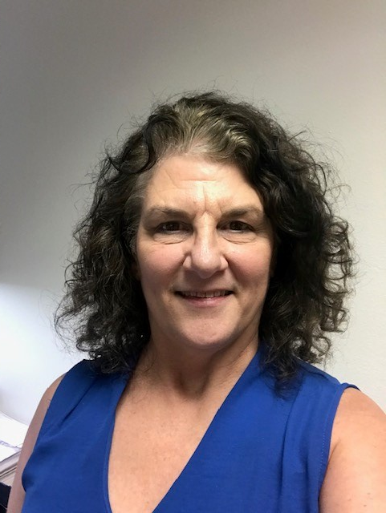

Don’t forget to connect with us on social media!
ACUA Virtual Learning Director
Lisa Gendusa, CIA, CFE
Internal Auditor
Texas State University System
ACUA Virtual Learning Volunteer
Jonathan G. Stadig, Senior Auditor
University of Massachesetts

Slide 3


Today’s Presenter(s)
Martin Howell, CCA
Principal
mhowell@forthillassociates.com
(864) 250-9065
Curt Plyler, CFA, CCA
Principal
cplyler@forthillassociates.com
(864) 274-0992
Consultancy founded in 2006 which focuses solely on Construction Contract Auditing
Significant focus on Higher Education and Healthcare clients
Audit philosophy of proactively identifying potential issues and establishing financial controls prior to contract execution
Services include “Owner-specific” Audit Training for Inhouse Staff
3
Notes:
3

Slide 4
Presentation Overview
Construction Contracts & The Necessity of Addressing Issues Prior to Contract Execution
Ensuring Construction Contract Compliance
COVID-19 Impacts
Sample for Illustrative Purposes Only
4
Notes:
4

Slide 5
Typical Construction Contract Types
Design-Bid-Build
  Traditional “hard bid” or “low bid” contract
Multi-Prime
  Owner contracts separately with a General Contractor, Mechanical Contractor, Electrical Contractor, etc. to construct a single project
Design-Build
  Owner executes one contract with a single entity to both design and construct a facility
Construction Manager @ Risk
  “Cost plus” contract that includes a Guaranteed Maximum Price
Integrated Project Delivery (IPD)
  Single three-party contract (Owner-Designer-Contractor)
5
Notes:
5

Slide 6
Guaranteed Maximum Price Contracts
Guaranteed Maximum Price (GMP) Contracts are often used in larger projects to get construction started earlier, at a stage when the final drawings and scope have not yet been determined
The GMP value is intended to represent the cost of the work plus a fee
The Owner is only obligated to pay the actual cost incurred plus a fee up to a cap, the GMP value
GMP contract values should be less than fixed price (i.e., ‘hard bid’) contracts, as the Construction Manager (CM) or Contractor assumes less risk
  Construction Manager-at-Risk (CMR) involves the CM in the design phase
  Preconstruction services work on a CMR project is done by the CM for a separate fee, with no guarantee of the CM being given the work for the construction phase
  The GMP value is agreed between the Owner & the CM/Contractor when the design & drawings have been more fully defined
6
Notes:
6

Slide 7
Guaranteed Maximum Price Contracts
The American Institute of Architects (AIA) A102 (Contractor) or A133
(CM) contract documents are the most commonly used versions of this type of agreement
The AIA A133 document includes Preconstruction Services
  If there is compensation for these services, it is typically either for a fixed amount or reimbursable costs incurred
  These services, however, are often provided at no charge, or as credit against the GMP, by the CM in order to secure construction phase work
7
Notes:
7

Slide 8
Guaranteed Maximum Price Contracts
GMP Contracts segment the recovery of project costs into various components
General Conditions
  Cost of Managing the Project
    Salaried labor
    Mobilization Costs/Other Costs of Doing Business on Project Site
    Trailer
  Contract terms may ‘fix’ this amount, but a ‘cap’ (based on actual costs) similar to the GMP Cost of the Work is recommended
Cost of Work
  Subcontracts
  Self-performed work
Insurance/Bonds
Fee (a percentage of the project cost or a stipulated amount)
8
Notes:
8

Slide 9
Guaranteed Maximum Price Contracts
GMP Contracts segment the recovery of project costs into various components
General Conditions
  Cost of Managing the Project
    Salaried labor
    Mobilization Costs/Other Costs of Doing Business on Project Site
    Trailer
  Contract terms may ‘fix’ this amount, but a ‘cap’ (based on actual costs) similar to the GMP Cost of the Work is recommended
Cost of Work
  Subcontracts
  Self-performed work
Insurance/Bonds
Fee (a percentage of the project cost or a stipulated amount)
9
Notes:
9

Slide 10
Guaranteed Maximum Price Contracts
PROJECT COST MATRIX
The spaces marked with an "X" below indicate where the Institution wishes to allocate costs for the project. Please follow this as a guide in preparing your cost proposal for the project.

Slide 11
GMP Contract Considerations
Legal review of existing Contract template, as Owners may use same draft as a base template for multiple jobs
  Same draft can be the basis for multiple projects, but each should be individually tailored and the job individually analyzed
  Costs for items such as insurance and internal labor can be identified
  All parties should ensure their understanding of the line item significance as to caps and risk
  Risks should be assessed to the party best able to manage the risk
11
Notes:
11

Slide 12
GMP Contract Considerations
The Contract language should be refined to give fair protection to the Owner
As compared to a fixed price (i.e., ‘hard bid’) contract, less risk may exist due to the participation in preconstruction
  involvement in the preconstruction services helps identify and resolve cost concerns inherent in the Architect or Engineer’s design choices
  ability to bid the documents
  competitive market conditions will dictate the Subcontract bids
In addition to the GMP cap, a separate cap on the General Conditions costs should be included
12
Notes:
12

Slide 13
GMP Contract Considerations: Contingency
Contingency needs to identified and defined
Who owns it? Who can draw on it? When can it be released?
Usually defined, priced and negotiated in preconstruction
By example, Owners can use contingency to cover aspects of its risk such as the deductible for a Builder’s Risk policy
An early release gives the Owner money to use during the job
13
Notes:
13

Slide 14
GMP Contract Considerations: Insurance
The relationship of insurance and defective work correction, during the project, and after, needs to be identified
  The difficulty of defining and assigning risk in relation to insurance coverage needs to be understood
Post construction defects correction, and its impact on project cost, needs to be considered and defined – Who is paying for it???
  Can the CM/Contractor, post-construction, bill for the cost of correcting defective work against a savings realized at the end of construction?
  Performance bonds & General Liability Insurance will cover this risk, but SubGuard may not
14
Notes:
14

Slide 15
GMP Contract Considerations: Insurance
Builders Risk (BR) can be better managed and deductible risk allocated. Access to the contingency can be afforded for BR deductibles
Subcontractor Default Insurance (SDI)/SubGuard and other products can be assessed during preconstruction
Additional insurance protection can be considered
Use of “wrap” policies can be evaluated & their terms carefully considered
15
Notes:
15

Slide 16
Guaranteed Maximum Price Contracts Moving to Contract Execution
Resolving & mitigating issues prior to Contract execution is worth the effort to avoid issues later in the project
  Establishes accountability
  Eliminates future disputes
  Opportunity to negotiate issues
  Constructability considerations can be assessed & the drawings refined prior to bids by Subcontractors
  CM/Contractor can add its expertise in the evaluation of the design concepts chosen
Perform a Pre-Construction Contract Review
  Enables competitive pricing & control of costs (proactive review of CM’s/Contractor’s billing methodology compared to the underlying Contract)
  Anything not defined as General Conditions or Cost of Work should be covered in the CM/Contractor fee
16
Notes:
16

Slide 17
Guaranteed Maximum Price Contracts Moving to Contract Execution
Defining project costs (in eliminating design & inconsistencies in constructing design issues) prior to Contract execution should be a primary concern of the Project Owner
Without proper segmentation, the CM/Contractor has an incentive to include items the Owner might believe are covered in corporate overhead
The ‘cost’ for reimbursable items is often a pre-defined amount or percentage. These amounts should be validated prior to Contract execution to ensure they represent the actual cost incurred by the CM/Contractor
  Base contract language states actual cost incurred, but language is often amended to allow reimbursement based on a pre-defined amount or percentage
  Validation of the fixed amount or percentage should occur prior to Contract execution
17
Notes:
17

Slide 18


Entities Involved in the Contract Execution
Board
Administration
Bank
Attorneys
Architects
Engineers
Project Manager
General Contractors
Sub-Contractors
Accounting
Internal Audits
Accounts Payable - Owner
Accounts Receivable - GC

Slide 19
Guaranteed Maximum Price Contracts
Monitoring Project Costs after Contract Execution
Properly monitoring project costs is paramount to the Owner, as their responsibility is for the actual costs incurred, meaning underruns in project cost to the GMP should accrue to the Owner’s benefit
Effective monitoring prevents the possible utilization of hidden profit centers by the CM/Contractor
Effective monitoring allows the specific cost directives of the Contract reached by Owner, CM/Contractor, and Legal to be followed
19
Notes:
19

Slide 20
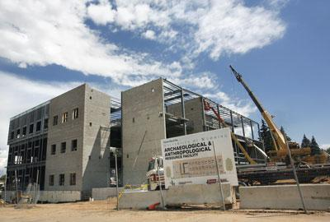
Pre-Construction Contract Reviews
Pre-Construction Contract Reviews eliminate ambiguities in Contract language, and the risks associated, and evaluate any rates the CM/Contractor is planning on employing for both reasonableness and the reimbursable nature of all components comprising these rates. This collaborative approach ensures all parties are on the same page as the project moves forward. Consideration should also be given to the cost of management and the benefits achieved. Rates evaluated under a pre-construction contract review include, but are not limited to:
  Billable Rates
  Labor Burden
  Overtime Labor Burden
  Rates for CM/Contractor Insurance
  Rates for Information Technology Charges
  Rates for CM/Contractor-Owned Equipment
  Change Order Markups
20
Notes:
20

Slide 21
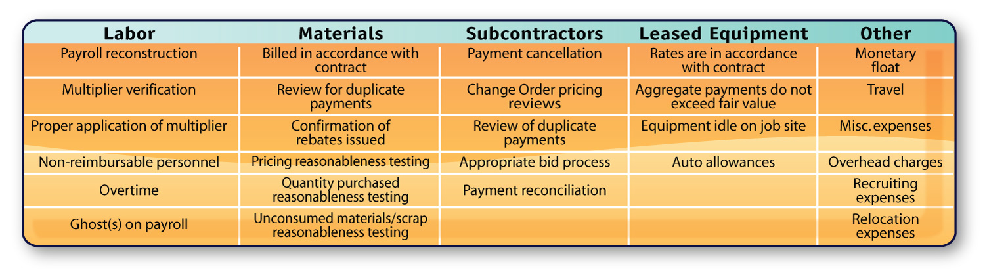
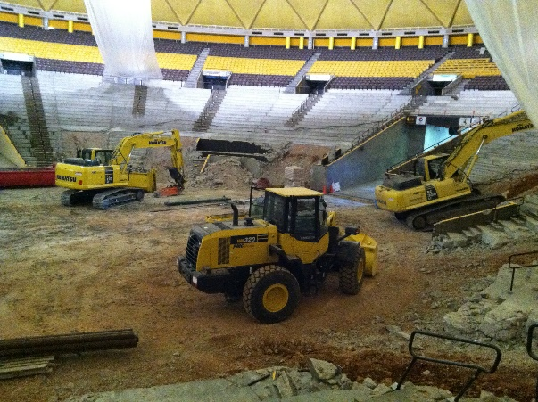
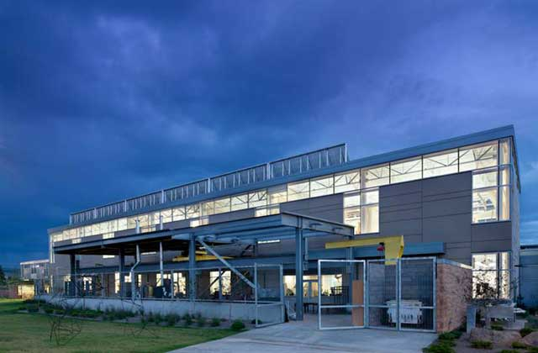
Areas of Leakage
21
Notes:
21
FHA

Slide 22
Owner Risk Area: Billable Rates
Notes:
22

Slide 23
Owner Risk Area: Labor Burden
23
Notes:
23

Slide 24
Owner Risk Area: Labor Burden
24
Notes:
24

Slide 25

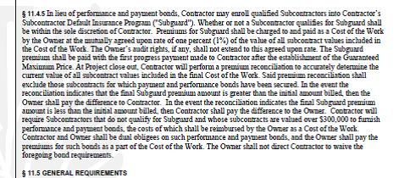
Owner Risk Area:
CM/Contractor Insurance
Fixed rates charged for P&P bonds, General Liability Insurance, Builder’s Risk, and SubGuard in lieu of actual costs represent another significant area of opportunity for the CM/Contractor
Sample for Illustrative Purposes Only
25
Notes:
25

Slide 26
Owner Risk Area:
CM/Contractor Insurance
Project - General Liability Insurance Rate Components
Components | Audit Comments
Casualty Insurance | OK
Workers Compensation Insurance | Billded directly in labor burden
General Liability Insurance | OK
GL - Architecture Division | Not Applicable
Automobile Liability | OK
Umbrella Liability | OK
International Excess / DIC | OK
Property All Risk/ Inland Marine | OK
Professional/Pollution Liability | Not Required Owner's Contract
Network Security Liability (Cyber) | Not Required Owner's Contract
Management Liability | Not Required Owner's Contract
Kidnap Ransom Extortion | Not Required Owner's Contract
Surety Program | Unknown
Aviation Liability (Drones) | Not Required Owner's Contract
Brokerage/Consulting | OK
Department Overhead | Overhead
26
Notes:
26

Slide 27
Owner Risk Area: Rates for Information Technology Charges
AIA Contract allows for project-specific IT expenditures
  Laptop computers
  Connectivity
  On-site support
  On most projects, project-specific IT is typically between 0.15 and 0.30% of project cost
AIA Contract does not allow for corporate overhead IT expenditures
  Accounting systems
  Home office servers
  Home office support
27
Notes:
27

Slide 28
Owner Risk Area: Rates for CM/Contractor-Owned Equipment
28
Notes:
28

Slide 29
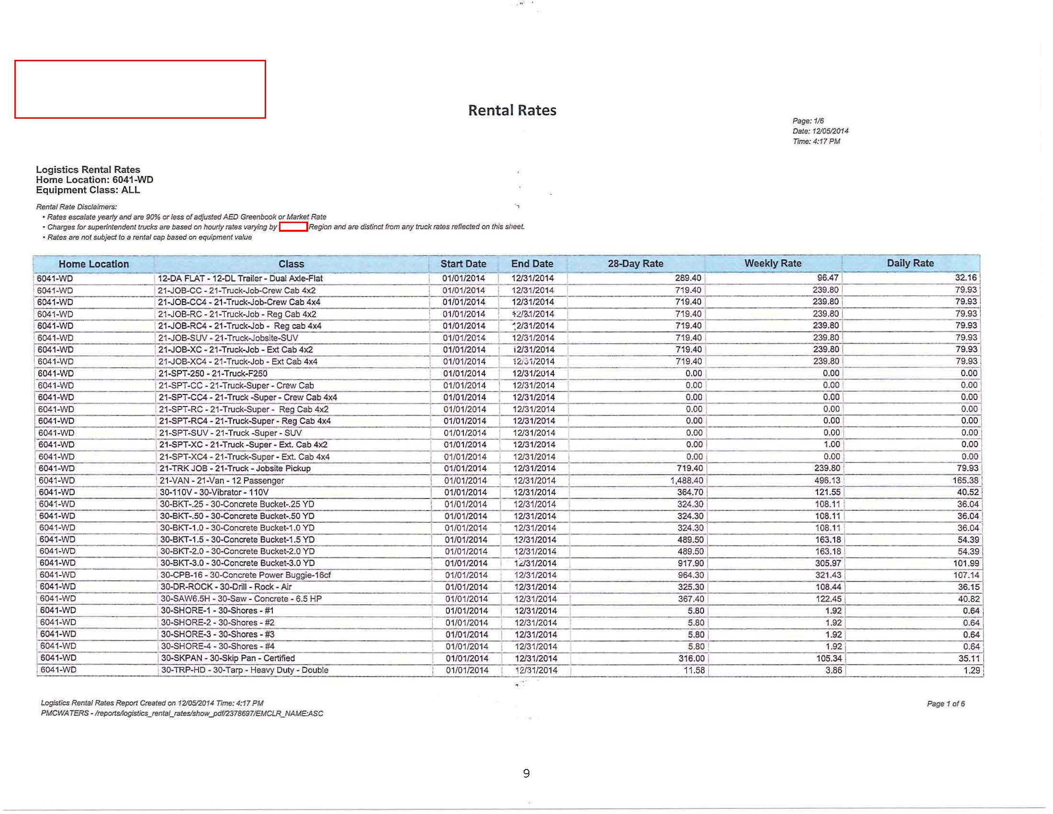
Owner Risk Area: Rates for CM/Contractor-Owned Equipment
29
Notes:
29

Slide 30
Owner Risk Area:
Change Orders
Validation of various markups
  Is markup, overhead and profit (OH&P), insurance, bonds, etc. to be applied to both additive and deductive Change Orders?
  Is OH&P cap defined separately for each tier (i.e., CM/Contractor, Subcontractor, Sub-subcontractor)?
  Can the CM/Contractor get separate markups for its role on self-performed work?
  Is aggregate markup capped?
  Inclusion of a markup template in your Contract documents
Other Change Order Concerns
  Validation of costs (material, labor, etc.)
  Identify duplicate scope
  Review of approval process
30
Notes:
30

Slide 31
Owner Risk Area:
Change Orders
31
Notes:
31

Slide 32
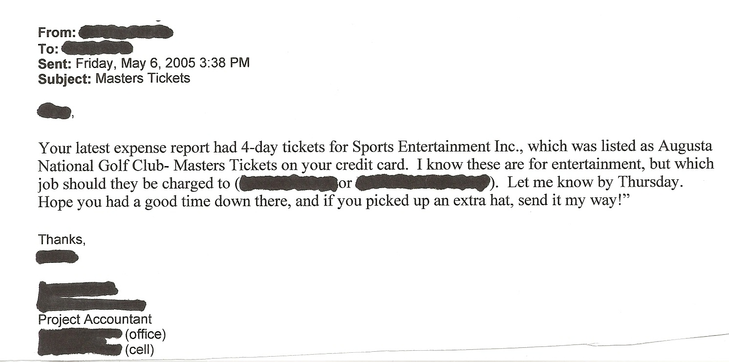
Owner Risk Area:
Miscellaneous Other Items
32
Notes:
32

Slide 33
Interim/Closeout
Construction Contract Reviews
Construction Contract Reviews audit billings to the lowest source document to validate the reimbursable nature of the billing pursuant to the Contract Documents
Any rates employed are validated for both accuracy and the reimbursable nature of the various components comprising the rate
Review of Change Orders for the application of markups along with approval process
Closeout Audit
  Ensures Contract compliance since last interim audit
  Ensures all credits due from periodic audit(s) have been processed
  Reconciles payment application to latest job cost report
33
Notes:
33

Slide 34
COVID-19 – A New Risk to Consider…
COVID-19 Construction Impacts Include:
  Additional Safety Requirements
    Temperature checking
    PPE
    Incremental cleaning
  Adverse Productivity Impacts
    Alternate shifts
    Lack of skilled labor
    Sharing of equipment
    Supply chain disruptions driven by manufacturing/delivery delays and shutdowns
  Negative Schedule Impacts
    Delays impacting critical path milestones
    Additional requests for Claims
    Project cancellations
34
Notes:
34

Slide 35
COVID-19 – A New Risk to Consider…
Newly created guidelines to help contractors and owners navigate these new conditions and continue work with limited confusion are often difficult to interpret and subject to change.
Owners must present clear expectations to contractors while remaining vigilant on timelines and maintaining good documentation. It is highly recommended to validate all COVID-19 related costs as they arise as opposed to settling at project conclusion.
35
Notes:
35

Slide 36
Top Techniques to Avoid Unnecessary Costs
What Techniques Can Be Used to Avoid Unnecessary Costs in Your Construction Projects?
Conduct a Pre-Construction Contract Review prior to Contract Execution.
Appropriate General Conditions costs should be agreed as reimbursable as incurred up to a maximum cap.
Auditing multiple periods at once provides insights into trends and overcharges that might not be apparent in the audit of one specific period.
36
Notes:
36

Slide 37

Fort Hill Associates, LLC
(877) 286-0408
www.forthillassociates.com
37 Villa Road
Suite 106
Greenville, SC 29615
37
Notes:
37

Slide 38
Upcoming ACUA Events
Webinar
July 2021 – Baker Tilly: Hot Topics in Athletics
AuditCon
September 19 - 23, 2021

Slide 39



Stay Updated
The College and University Auditor is ACUA's official journal. Current and past issues are posted on the ACUA website.
News relevant to Higher Ed internal audit is posted on the front page. Articles are also archived for your reference under the Resources/ACUA News.
Get Involved
The latest Volunteer openings are posted on the front page of the website.
Visit the listing of Committee Chairs to learn about the various areas where you might participate.
Nominate one of your colleagues for an ACUA annual award.
Submit a conference proposal.
Present a webinar.
Become a Mentor
Write an article for the C&U Auditor.
Write a Kick Starter.
Connect with Colleagues
Subscribe to one or more Forums on the Connect ACUA to obtain feedback and share your insights on topics of concern to higher education internal auditors.
Search the Membership Directory to connect with your peers.
Share, Like, Tweet & Connect on social media.
Get Educated
Take advantage of the several FREE webinars held throughout the year.
Attend one of our upcoming conferences:
Audit Interactive
March 21 – 24, 2021
Virtual
AuditCon
September 19 – 23, 2021
Hybrid
Contact ACUA Faculty for training needs.
Solve Problems
Discounts and special offers from ACUA's Strategic Partners
Kick Starters
Risk Dictionary
Mentorship Program
NCAA Guides
Resource Library
Internal Audit Awareness Tools
Governmental Affairs Updates
Survey Results
Career Center......and much more.
www.ACUA.org

Slide 40

ACUA Kick Starters
Use a Kick Starter to launch your next audit!
Developed by ACUA members with subject matter expertise
Focused on higher education specific topics
https://acua.org/Audit-Tools/ACUA-Kick-Starters
Do you have a great idea for an ACUA Kick Starter? Contact John Winn at HJWINN@mailbox.sc.edu.

Slide 41


New Kick Starter Available!
CARES Act HEERF Compliance
Download today in the members-only Audit Tools section of www.ACUA.org

Slide 42
Next Kick Starter Coming July 15th!
Auditing Diversity and Inclusion
Download today in the members-only Audit Tools
section of www.ACUA.org

Slide 43


Slide 44
ACUA Mentorship Program
Mentorship is a proven method to help colleagues feel supported, drive workplace satisfaction, and foster member engagement in higher ed auditing.
The program is no longer focused on only small audit shops! The program has been expanded to be more inclusive of all types of shops.
The program is only a one-year commitment, but we encourage the mentorship to continue even after one year.
Consider signing up! Watch for registration deadlines to be communicated via email. For more information, go to https://acua.org/Member-Resources/Mentorship-Program

Slide 45

The ACUA Board of Directors decided to make AuditCon 2021 a limited hybrid event for all ACUA members and attendees.
AuditCon will be held September 19-23: live in Miami, Florida for a limited number of attendees, and live-streamed virtually!
We are confident with the new CDC guidelines that this hybrid option will bring the most value to ACUA members.
More information coming soon!

Slide 46


